Slide 1
Chapter 2
Elements of Computer Systems

Slide 2
Outline
Three Fundamental Abstractions
Naming in Computer Systems
Suggested Reading
  Cha 2.1, 2.2 (without 2.2.3-2.2.6)

Slide 3
System & Names
System is a bunch of resources,
glued by names
  Often the best way to view or build
  Often most interesting action is in the names
What resources?
  view them as 3 basic types

Slide 4
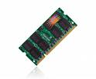

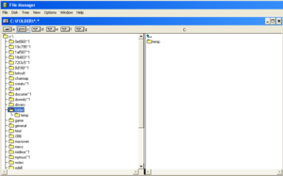
Fundamental abstractions
Memory
  Read/write
Consistency
-----------------------------------------
recall, processing, and communication
Notes:
* Fundamental abstractions
storage
mem, disk
layered: data struct, FS, disk arrays
interpreters
cpu
programming language e.g. java VM
communication
wire, ethernet
layered: internet, ssh, unix pipe
we'll talk about all these abstractions during the course

Slide 5
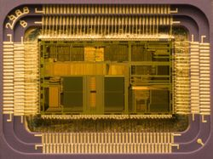
Fundamental abstractions
Interpreter
  Instruction repertoire
  Environment
  Instruction pointer
  ------------------------------------
  recall, processing, and communication
(loop (print (eval (read))))
Notes:
* Fundamental abstractions
storage
mem, disk
layered: data struct, FS, disk arrays
interpreters
cpu
programming language e.g. java VM
communication
wire, ethernet
layered: internet, ssh, unix pipe
we'll talk about all these abstractions during the course

Slide 6
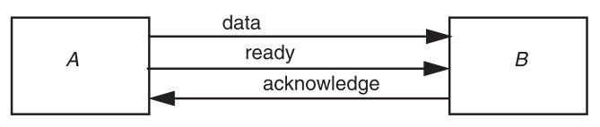
Fundamental abstractions
Communication links
  Send/receive
  -------------------------------------
  recall, processing, and communication
Notes:
* Fundamental abstractions
storage
mem, disk
layered: data struct, FS, disk arrays
interpreters
cpu
programming language e.g. java VM
communication
wire, ethernet
layered: internet, ssh, unix pipe
we'll talk about all these abstractions during the course

Slide 7
Why these Abstractions
Supply fundamental functions of recall, processing, and communication
The only hardware abstractions that have proven both
  to be widely useful and
  to have understandably simple interface semantics

Slide 8
Why these Abstractions
System designers build layers on this fundamental base
  Elaborate the same three abstractions
  Rearrange and repackage them to create
    features that are useful and
    interfaces that are convenient for each application

Slide 9
Abstractions to names
All three abstractions ------rely on names
  Memory------ stores named objects
  Interpreter----- manipulates named objects
  Communication link----- connects named entities
Much of system design is naming
  Glue

Slide 10
Memory
Interface
  WRITE(name, value)
  value ← READ(name)
Properties
  Volatile: Loses values when power removed
  Durability: How long it keeps its value
Access unit can be bit, byte, word, record, file, etc.

Slide 11
Coherency & Atomicity
Read/write coherency
  READ returns the most recent WRITE
Before-or-after atomicity
  READ or WRITE should complete before or complete after other READs or WRITEs
Both desirable and difficult to achieve。--- why？？？

Slide 12
Why these are difficult? - 1
Concurrency
  READ and WRITE at the same time
  Multiple WRITEs at the same time
  Need arbiter
Performance enhancements
  Out of order processor (Weak consistency)
    Compilers - while (QueueHead ==0)

Slide 13
Why these are difficult? - 2
Cell size incommensurate with value size
    int64_t x; // on 32bit multicore
    X = 1; 0x0000000000000001 // On core1
    X = -1; 0xffffffffffffffff // On core2
    Read X Get 0xffffffff0000001 // On core3
Replicated storage
  Facebook: Two datacenters, one east coast, one CA
  Write on one coast, read immediately on the other

Slide 14
Memory latency and access size
How long does it take for a READ or WRITE to finish?
  Registers - 1 ns
  RAM - 100 ns
  Disk - 8 ms
Access size normally bigger for slower devices
  Register - 4 /8 bytes
  Memory - 64 bytes
  Disk - 512 bytes

Slide 15
Memory names and addresses
Memory names
  Hardware memory: (chip, row, column)
  Disk: (disk head, platter, sector)
Normally export as consecutive连续integers
  Better abstraction - simple mapper
  Called address
  Location-addressed memory

Slide 16
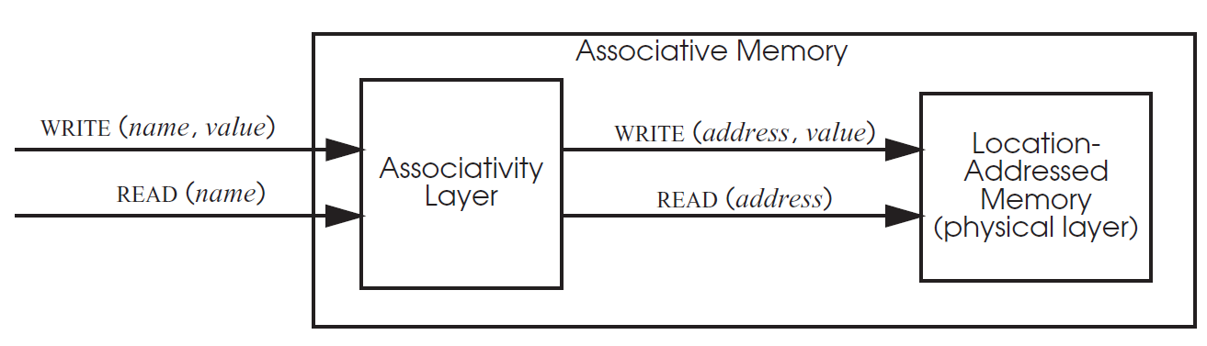
Associative memories
Use arbitrary strings for names
  Implemented by a mapping layer and a location-addressed memory
$ages[‘Peter’] = “32”;

Slide 17
Associative memories
Example
  Processor caches
  PHP
  $ages[‘Peter’] = “32”;
  $ages[‘Quagmire’] = “30”;
  $ages[‘Joe’] = “34”;

Slide 18
Interpreters

Slide 19
Interpreters - 1
Three components
  An instruction reference
    e.g. x86’s eip
  A repertoire （能力集）
    e.g. x86’s inst
  An environment reference
    e.g. x86’s current register, MMU settings
Multiple interpreters
  Usually asyncronous

Slide 20
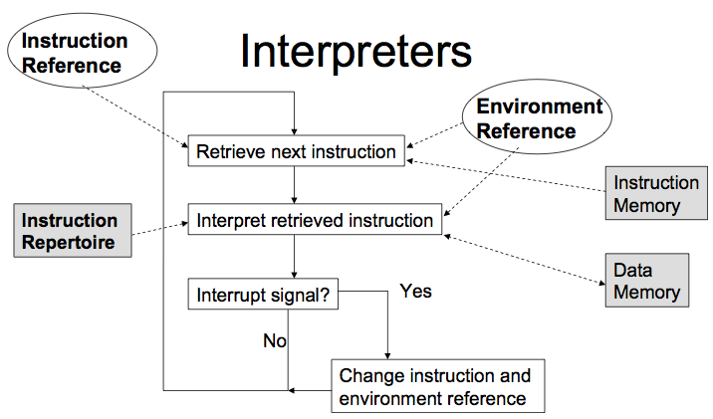
Interpreters - 2

Slide 21
Interpreter layers
Example: facebook.com
  Web server
    Embedded PHP
  Database server
    MySQL query engine

Slide 22
communication

Slide 23
Communicate links
Interface
  SEND( link_name, outgoing_message_buffer)
  RECEIVE( link_name, incoming_message_buffer)
Link_name
  Point-to-point link (single receiver)
  Name in message
Different than copy
  Messages might be take a long time, be changed, even lost etc.
  Errors, security
Example
  browser sends a message to facebook.com

Slide 24
Module use of names
Two ways modules uses a named object:
  By value
    Module gets a copy of the named object
    Enhance modularity, but not easy to share
  By reference
    Module operates directly on the named object
    Purpose #1: Sharing and Organization
      Most communication happens using names
    Purpose #2: Delayed binding to an object
      Supports replaceability and indirection

Slide 25
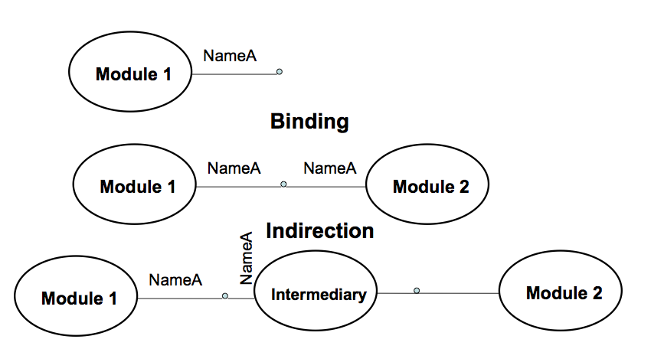
Modules and names

Slide 26
Naming schemes
Three parts
  Name space: Symbols and syntax rules for generating names
  Name-mapping algorithm: Maps names to values
  Universe of values: All possible of values
Terminology
  Binding – A mapping from a name to value
  A name that has a mapping is bound
  A name mapping algorithm resolves a name

Slide 27
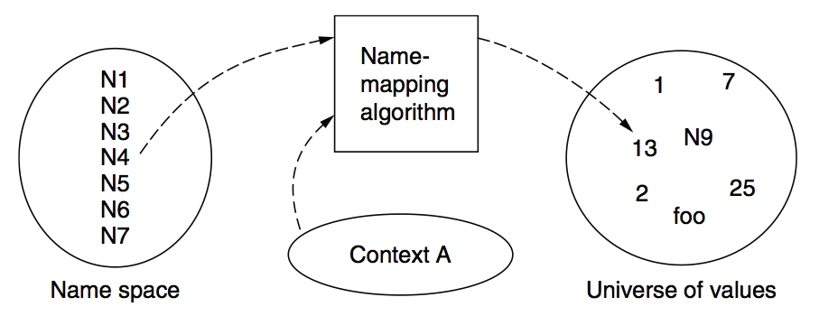
Naming model

Slide 28
Naming context
Name lookup typically done in a context
  Examples:
    Mail cse@fudan.edu.cn
    Dial: 5553355
    “Hey, you!”
Name spaces with only one possible context are called universal name spaces
  Example: US social security numbers

Slide 29
Determining context - 1
Hard code it in the resolver
  Examples: Many universal name spaces work this way
Embedded in name itself (qualified names)
  zhang@fudan.edu.cn：
    Name = “zhang”
    Context = “fudan.edu.cn”
  /ppi.fudan.edu.cn/cse/2011/README ：
    Name = “README”
    Context = /ppi.fudan.edu.cn/cse/2011/”

Slide 30
Determining context - 2
Taken from environment (Dynamic)
  “ $ rm foo”:
    Name = “foo”,
    context is current dir
  Read 0x7c911109:
    Name = “0x7c911109”,
    context is thread’s address space
Many errors in systems due to using wrong context

Slide 31
Interpreter naming API
value ← RESOLVE (name, context)
  Return the mapping of name in the context
status ← BIND (name, value, context)
  Establish a name to value mapping in the context
status ← UNBIND (name, context)
  Delete name from context
list ← ENUMERATE (context)
  Return a list of all bindings
result ← COMPARE(name1, name2)
  Check if name1 and name2 are equal

Slide 32
Uniqueness
Many naming systems are not unique
  Names can map to-→ 0, 1, or many values
    RESOLVE can return NULL or a list of values
  A value may have -→ 0, 1, or many names
    Reverse RESOLVE can return NULL or a list
Unique identity name space
  Never reused – called a Stable Binding
    Your fudan student number
    Many billing systems have “Customer #s”

Slide 33
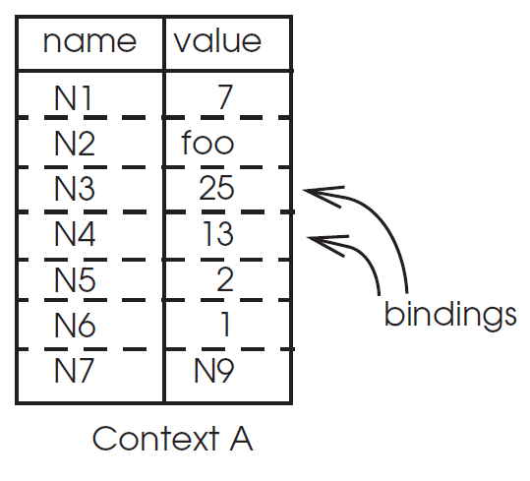
Name mapping algorithms
Table lookup
  Find name in a table
  Examples: Phone book, People name -2- phone number and -2- phone
  Context: Specify which table to use
Recursive lookup
Multiple lookup

Slide 34
Table lookup example
Integer----registers
Memory address --- phycical cells, virtual memory
Directory table

Slide 35
Name conflicts - 1
Names are used to compose modules
  Each module can be built independently with its own naming context
Naming conflicts can occur when combining modules together
Example: Linking large modules together
  Problem: Linker croaks or wrong routine called
  Solutions: Renaming? Wrapping?

Slide 36
Name conflicts - 2
In large systems care is needed in naming
  Careful about what names you export from a module
    Naming conventions for extern symbols
  Might not be able to change names once exported
    Example: Linux device drivers
  Bad modules
    Pollute name space, expose internals, confuse

Slide 37
Addresses
Addresses are used as both names and locators
  e.g. IP address: 171.64.64.64, 1950s phone number, I/O device address
  Highly useful but fragility

Slide 38
Addresses
Work-around when object moves
  Change all references - can be painful
  Make it work for both new and old
  Have client search if resolve fail
Indirection is frequently the solution
  Update indirection map to handle moves
  Examples: host names, cell phone numbers, etc.

Slide 39
Summary
Understanding a naming system:
  What is the syntax for name?
  What are the values?
  What is the naming resolution algorithm?
  Where does a name’s context from?

